Slide 1



HR_EMPLOYEE_ATTRITION
Meri Skill Training
Project For analyze the status of the employee
ENG: Khalid Saif
EMAIL: khalidm7422@gmail.com

Slide 2

OVERVIEW
COM Inc. is a big-sized technology company with 1470 employees. Over the past year, the company has experienced an unexpectedly high turnover rate, particularly among its software developers and technical support staff. The HR department has been tasked with analyzing this attrition to uncover the underlying causes and develop strategies to mitigate it.

Slide 3
HR collects data on the following variables for each employee of the company in the last year:
Data Collection
Employee ID
Gender
Education Field
Age
Marital Status
Department
Job Role
Attrition
Business Travel
Daily Rate
Distance From Home
Education
Environment Satisfaction
Hourly Rate
Job Involvement
Job Level
Job Satisfaction
Monthly Income
Monthly Rate
Num Companies Worked
Over Time
Percent Salary Hike
Performance Rating
Relationship Satisfaction
Stock Option Level
Total Working Years
Training Times Last Year
Work Life Balance
Years At Company
Years In Current Role
Years Since Last Promotion
Years With Curr Manager

Slide 4




Data Visualization
Load
EDA
DATA CLEANING
Transformation
DATA SOURCE
JUPYTER NOTEBOOK
POWER BI

Slide 5

TASK 1
TRANSFORMATION
LOAD THE DATASET
EDA
DATA CLEANING
JUPYTER NOTEBOOK

Slide 6
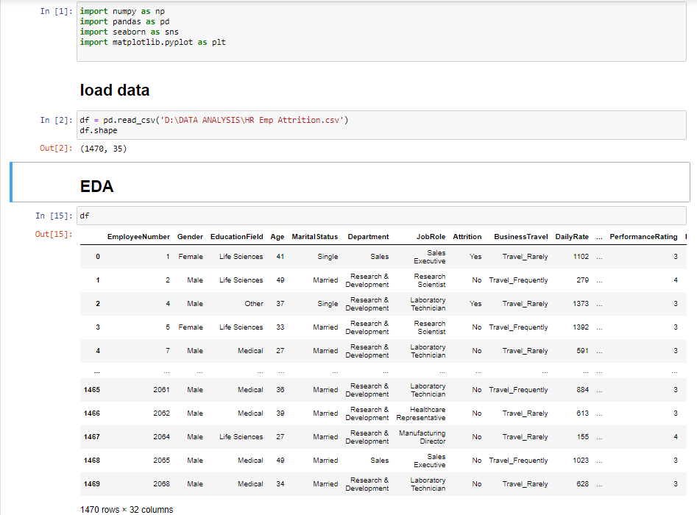
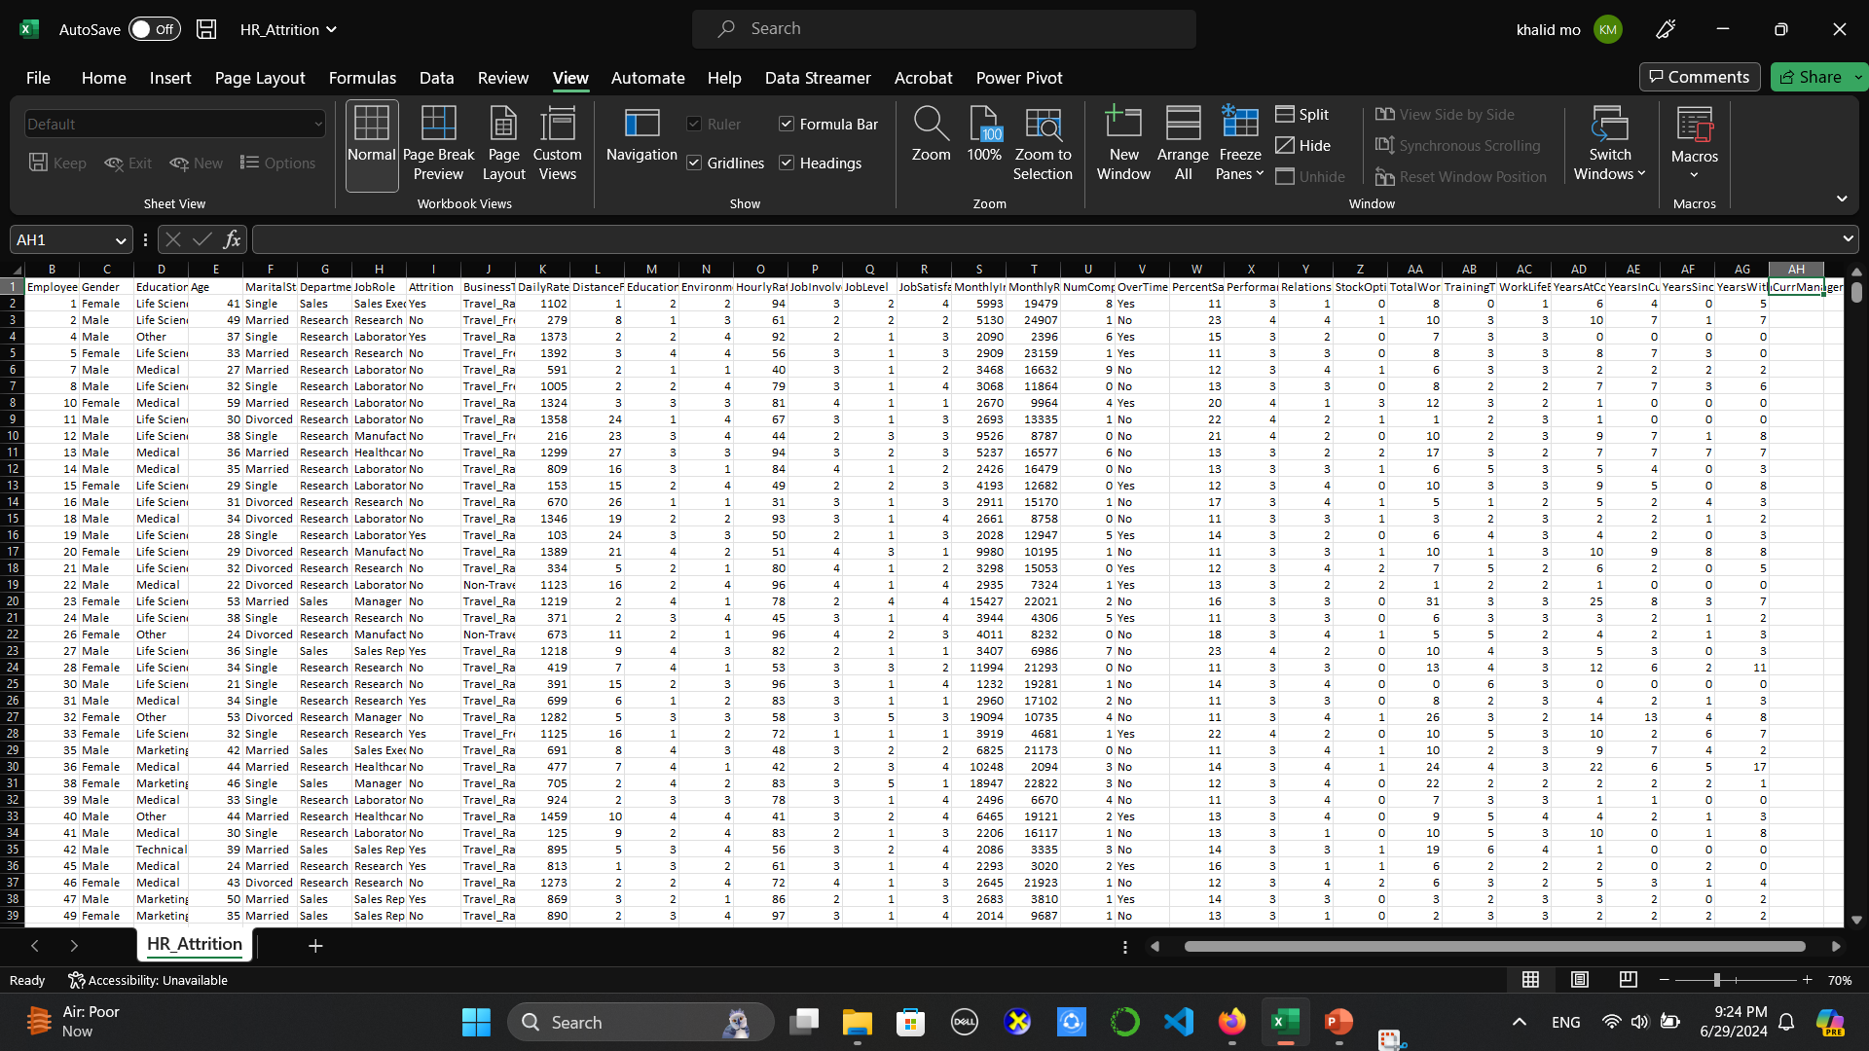
LOAD THE DATA SET INTO JUPYTER NOTEBOOK

Slide 7
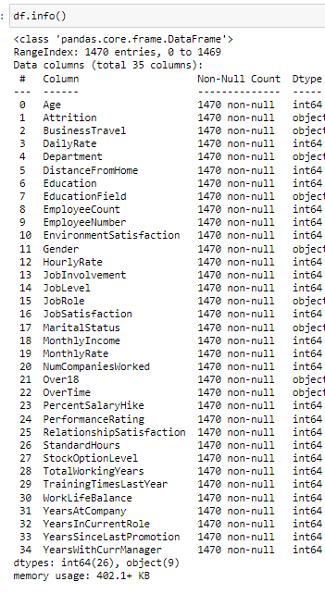
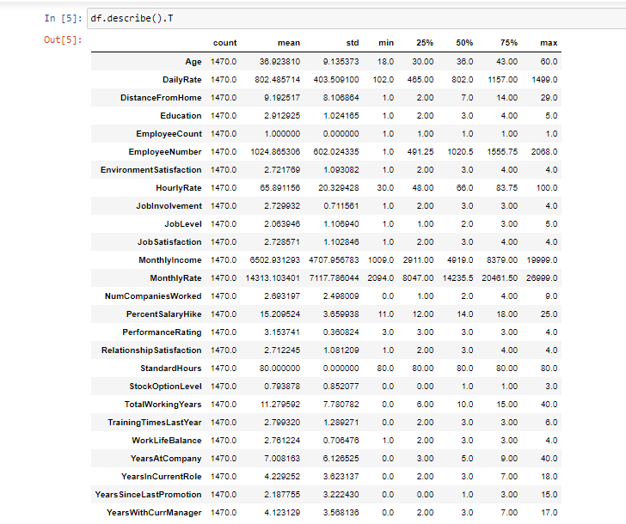
EDA TECHNIQUE

Slide 8
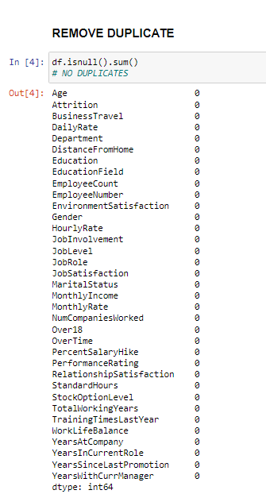
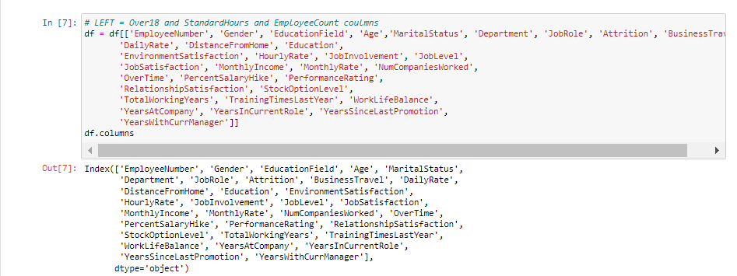
DATA CLEANING

Slide 9
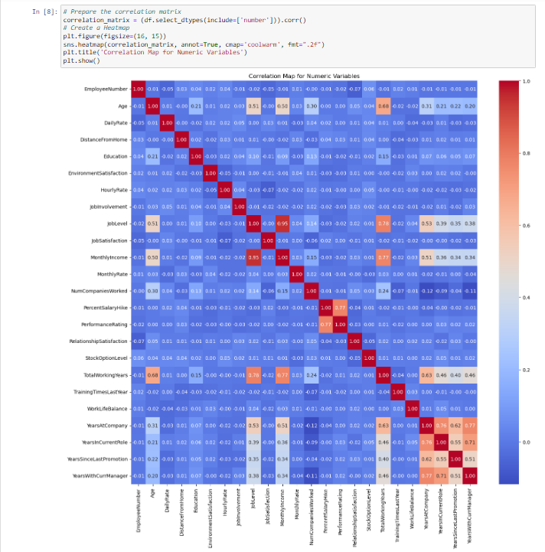
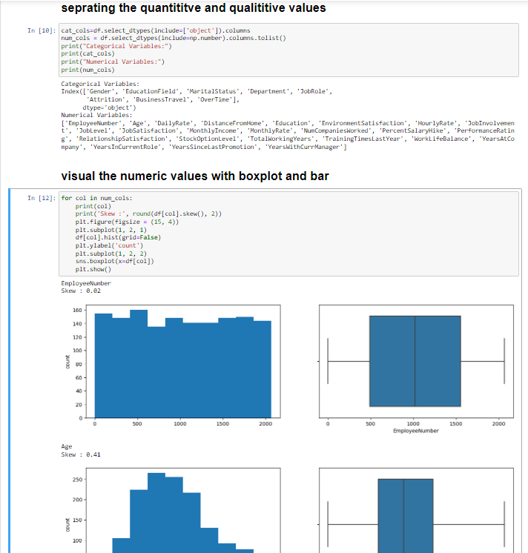
DATA VISUALIZATION

Slide 10
TASK 2
VISUALIZATION
LOAD THE DATASET
DATA VISUALIZATION
POWER BI

Slide 11

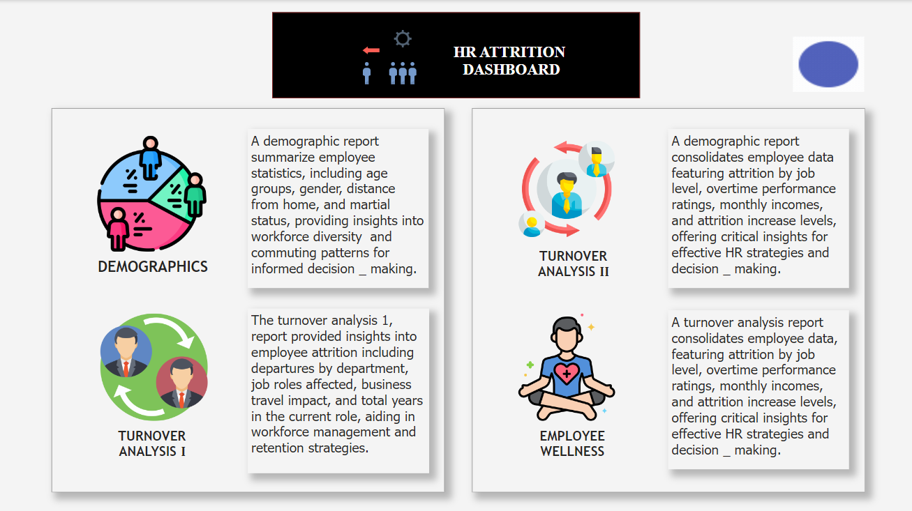
Story Telling

Slide 13
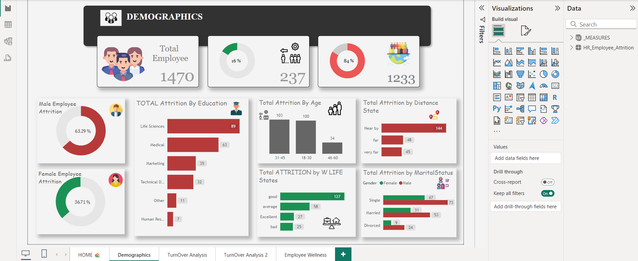

Slide 14
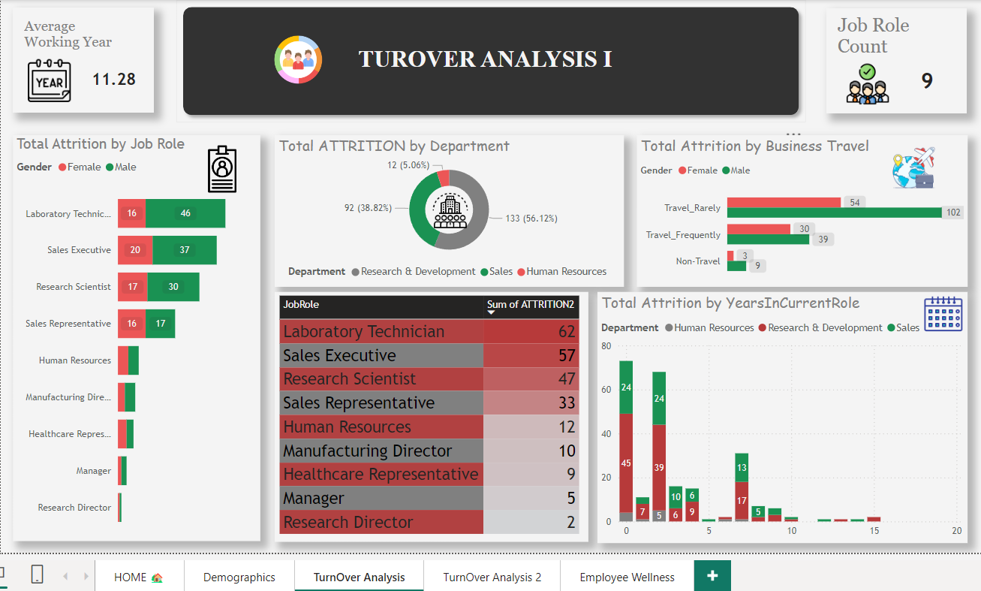

Slide 15
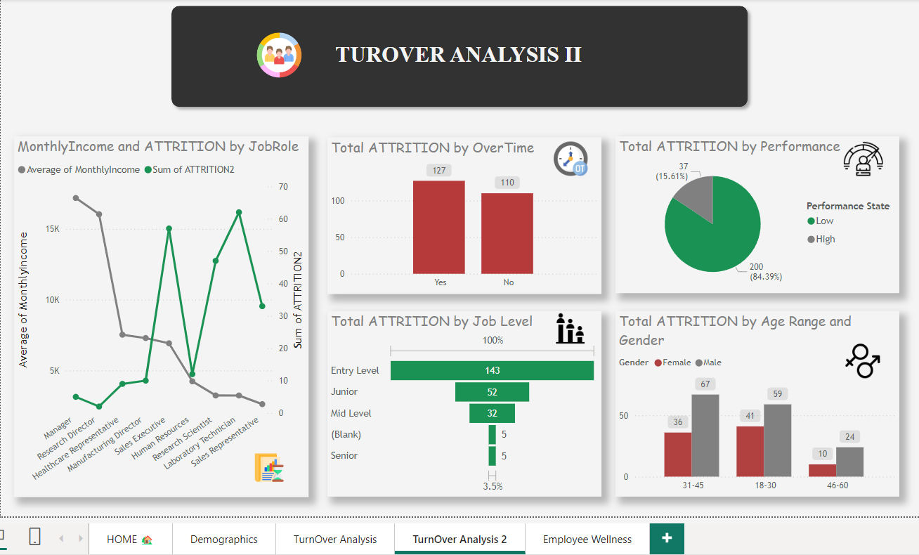

Slide 16
